Slide 1
5. Bitcoin Mining and Consensus
Mastering Bitcoin - Programming the Open Blockchain, 2nd Ed., 2017

Slide 2
Introduction (1/2)
The word “mining” is somewhat misleading. If you view mining only as the process by which coins are created, you are mistaking the means (incentives) as the goal of the process.
Mining is the mechanism that underpins the decentralized clearinghouse, by which transactions are validated and cleared. Mining is the invention that makes bitcoin special, a decentralized security mechanism that is the basis for P2P digital cash.
Mining secures the bitcoin system and enables the emergence of networkwide consensus without a central authority. The reward of newly minted coins and transaction fees is an incentive scheme that aligns the actions of miners with the security of the network, while simultaneously implementing the monetary supply.

Slide 3
Introduction (2/2)
Miners validate new transactions and record them on the global ledger. A new block, containing transactions that occurred since the last block, is “mined” every 10 minutes on average, thereby adding those transactions to the blockchain.
Transactions that become part of a block and added to the blockchain are considered “confirmed,” which allows the new owners of bitcoin to spend the bitcoin they received in those transactions.
Miners receive two types of rewards in return for the security provided by mining: new coins created with each new block, and transaction fees from all the transactions included in the block.
To earn this reward, miners compete to solve a difficult mathematical problem based on a cryptographic hash algorithm. The solution to the problem, called the Proof-of-Work, is included in the new block and acts as proof that the miner expended significant computing effort.

Slide 4
Bitcoin Economics and Currency Creation (1/2)
The process is called mining because the reward (new coin generation) is designed to simulate diminishing returns, just like mining for precious metals.
Bitcoin mining rewards decrease exponentially until approximately the year 2140, when all bitcoin (20.99999998 million) will have been issued.
In November 2012, the new bitcoin issuance rate was decreased to 25 bitcoin per block. In July 2016 it was decreased again to 12.5 bitcoin per block. It was decreased again to 6.25 bitcoin in May 2020.
After 2140, the amount of new bitcoin in each block drops to zero and bitcoin mining will be incentivized only by transaction fees.

Slide 5
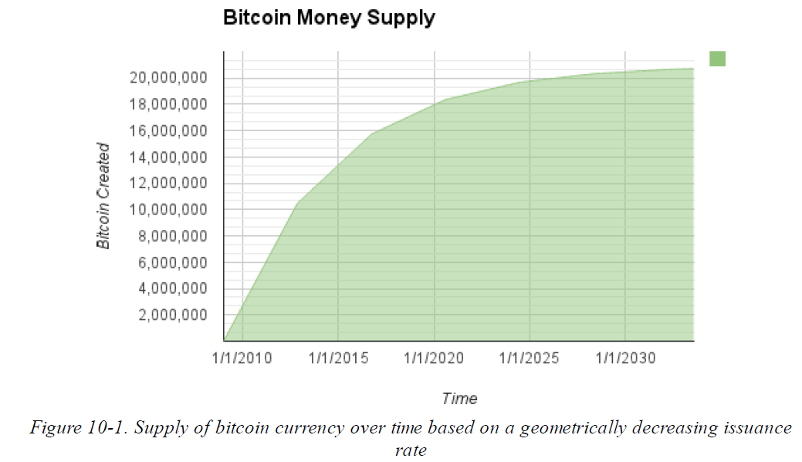
Bitcoin Economics and Currency Creation (2/2)

Slide 6
Ref. Deflationary Money
Deflation is the phenomenon of appreciation of value due to a mismatch in supply and demand that drives up the value (and exchange rate) of a currency.
The opposite of inflation, price deflation, means that the money has more purchasing power over time.
Many economists argue that a deflationary economy is a disaster that should be avoided at all costs. That is because in a period of rapid deflation, people tend to hoard money instead of spending it, hoping that prices will fall.
The positive aspect of deflation, of course, is that it is the opposite of inflation. Inflation causes a slow but inevitable debasement of currency, resulting in a form of hidden taxation that punishes savers in order to bail out debtors (including the biggest debtors, governments themselves).

Slide 7
Decentralized Consensus (1/3)
How can everyone in the network agree on a single universal “truth” about who owns what, without having to trust anyone?
All traditional payment systems depend on a trust model that has a central authority providing a clearinghouse service, basically verifying and clearing all transactions.
The blockchain is not created by a central authority, but is assembled independently by every node in the network. Somehow, every node in the network, acting on information transmitted across insecure network connections, can arrive at the same conclusion and assemble a copy of the same public ledger as everyone else.

Slide 8
Decentralized Consensus (2/3)
Satoshi Nakamoto’s main invention is the decentralized mechanism for emergent consensus.
Emergent, because consensus is not achieved explicitly —there is no election or fixed moment when consensus occurs. Instead, consensus is an emergent artifact of the asynchronous interaction of thousands of independent nodes, all following simple rules.
All the properties of bitcoin, including currency, transactions, payments, and the security model that does not depend on central authority or trust, derive from this invention.

Slide 9
Decentralized Consensus (3/3)
Bitcoin’s decentralized consensus emerges from the interplay of four processes that occur independently on nodes across the network:
Independent verification of each transaction, by every full node, based on a comprehensive list of criteria
Independent aggregation of those transactions into new blocks by mining nodes, coupled with demonstrated computation through a Proof-of-Work algorithm
Independent verification of the new blocks by every node and assembly into a chain
Independent selection, by every node, of the chain with the most cumulative computation demonstrated through Proof-of-Work
P1
P2
P3
P4

Slide 10
Independent Verification of Transactions
P1
Wallet software creates transactions by collecting UTXO, providing the appropriate unlocking scripts, and then constructing new outputs assigned to a new owner.
The resulting transaction is then sent to the neighboring nodes in the bitcoin network so that it can be propagated across the entire bitcoin network.
Before forwarding transactions to its neighbors, every bitcoin node that receives a transaction will first verify the transaction. Valid transactions are propagated across the network, while invalid transactions are discarded.
Each node verifies every transaction against a long checklist of criteria.
By independently verifying each transaction as it is received and before propagating it, every node builds a pool of valid (but unconfirmed) transactions known as the transaction pool, memory pool, or mempool.

Slide 11
Mining Nodes (1/4)
P2
A mining node is listening for new blocks, propagated on the bitcoin network, as do all nodes. However, the arrival of a new block has special significance for a mining node.
The competition among miners effectively ends with the propagation of a new block that acts as an announcement of a winner. To miners, receiving a valid new block means someone else won the competition and they lost.
The end of one round of a competition is also the beginning of the next round. The new block is not just a checkered flag, marking the end of the race; it is also the starting pistol in the race for the next block.

Slide 12
Mining Nodes (2/4)
For example
Jing’s mining node maintains a local copy of the blockchain and has assembled a chain up to block 277,314. Jing’s node is listening for transactions, trying to mine a new block and also listening for blocks discovered by other nodes.
As Jing’s node is mining, it receives block 277,315 through the bitcoin network. The arrival of this block signifies the end of the competition for block 277,315 and the beginning of the competition to create block 277,316.
During the previous 10 minutes, while Jing’s node was searching for a solution to block 277,315, it was also collecting transactions in preparation for the next block. By now it has collected a few hundred transactions in the memory pool.
Upon receiving block 277,315 and validating it, Jing’s node will also compare it against all the transactions in the memory pool and remove any that were included in block 277,315. Whatever transactions remain in the memory pool are unconfirmed and are waiting to be recorded in a new block.

Slide 13
Mining Nodes (3/4)
Jing’s node immediately constructs a new empty block, a candidate for block 277,316. This block is called a candidate block because it is not yet a valid block, as it does not contain a valid Proof-of-Work.
The block becomes valid only if the miner succeeds in finding a solution to the Proof-of-Work algorithm.
When Jing’s node aggregates all the transactions from the memory pool, the new candidate block has 418 transactions with total transaction fees of 0.09094928 bitcoin.
The first transaction in any block is a special transaction, called a coinbase transaction. Unlike regular transactions, the coinbase transaction does not consume (spend) UTXO as inputs. Instead, it has only one input, called the coinbase, which creates bitcoin from nothing. The coinbase transaction has one output, payable to the miner’s own bitcoin address.

Slide 14
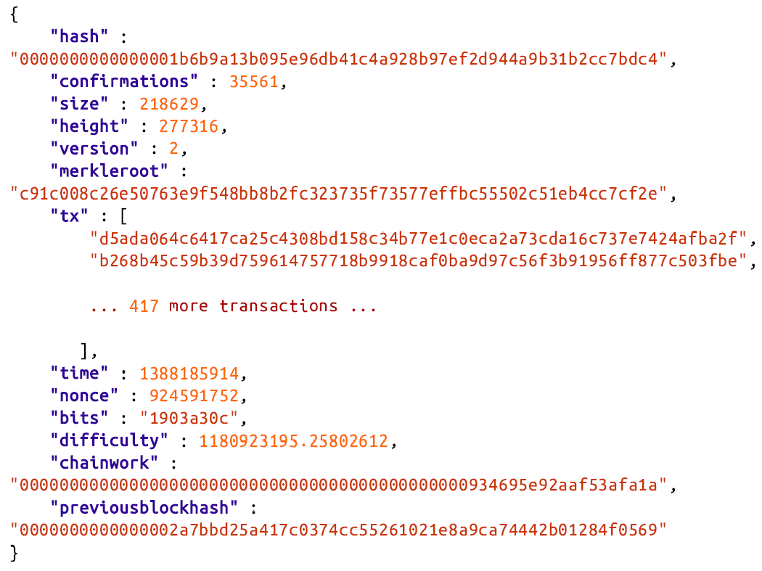
Mining Nodes (4/4)
(Candidate block of Jing’s node)
1st → coinbase transaction id
2nd transaction id

Slide 15
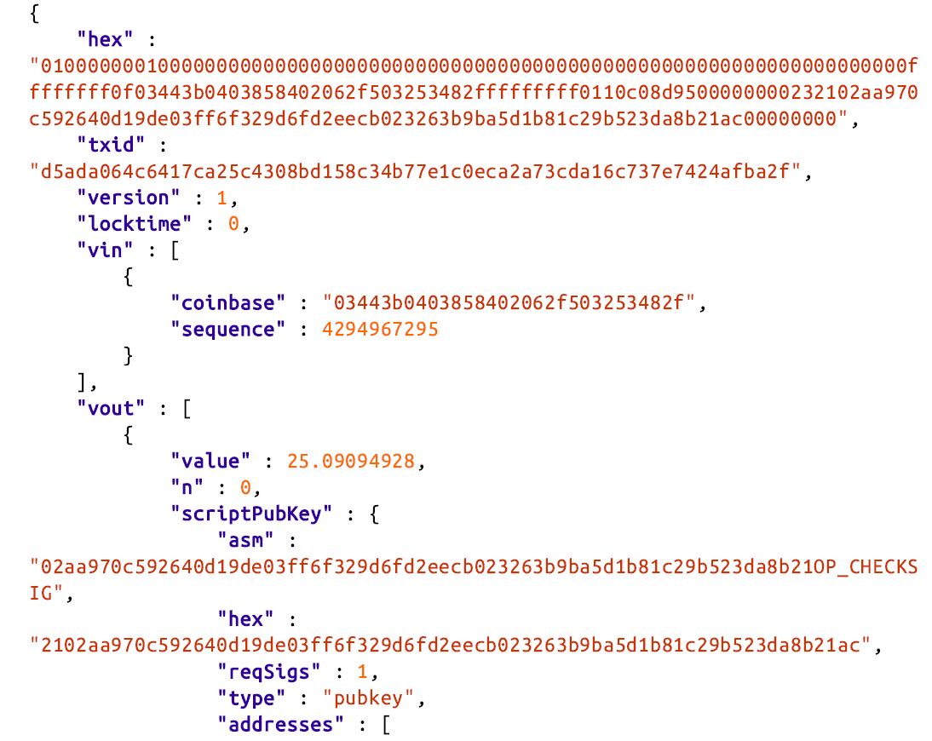
Coinbase transaction
In block 277,316, the total transaction fees are 0.09094928 bitcoin.
Because this block is at height 277,316, the correct reward is 25 bitcoin.

Slide 16
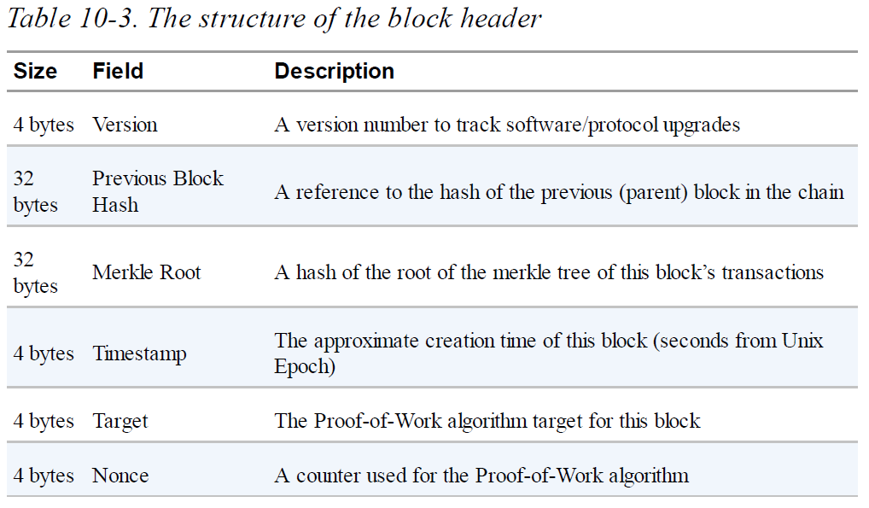
Constructing the Block Header (1/2)
The last transaction is duplicated if needed to make even # of leaf nodes
# of seconds elapsed from 1970/1/1, midnight UTC/GMT.
(initialized to zero)

Slide 17
Constructing the Block Header (2/2)
Previous Block Hash
By selecting the specific parent block, indicated by the Previous Block Hash field, Jing is committing his mining power to extending the chain that ends in that specific block. In essence, this is how Jing “votes” with his mining power for the longest-difficulty valid chain.
Target
It defines the required Proof-of-Work to make this a valid block. The target is stored in the block as a “target bits” metric, which is a mantissa-exponent encoding of the target. The encoding has a 1-byte exponent, followed by a 3-byte mantissa (coefficient).
The goal of mining is to find a value for the nonce that results in a block header hash that is less than the target.

Slide 18
Mining the Block (1/2)
In the simplest terms, mining is the process of hashing the block header repeatedly by SHA256, changing one parameter, until the resulting hash matches a specific target.
The hash function’s result cannot be determined in advance, nor can a pattern be created that will produce a specific hash value.
This feature of hash functions means that the only way to produce a hash result matching a specific target is to try again and again, randomly modifying the input until the desired hash result appears by chance.
Even though each attempt produces a random outcome, the probability of any possible outcome can be calculated in advance. Therefore, an outcome of specified difficulty constitutes proof of a specific amount of work.

Slide 19
Mining the Block (2/2)
The miner calculates the hash of this block’s header and sees if it is smaller than the current target.
If the hash is not less than the target, the miner will modify the nonce (usually just incrementing it by one) and try again. At the current difficulty in the bitcoin network (as of year 2017), miners have to try quadrillions (10¹⁵) of times before finding a nonce that results in a low enough block header hash.
Q: 4-byte nonce has only 2³² ≈ 4*10⁹ possible values. Why need to try more than 10¹⁵ times to find a solution?
Very probably no solution can be found with the given header fields and all possible nonce values. Need to try some time later, i.e. with a new timestamp value.

Slide 20
Retargeting to Adjust Difficulty (1/2)
The target determines the difficulty and therefore affects how long it takes to find a solution to the Proof-of-Work algorithm.
Why is the difficulty adjustable?
Bitcoin’s blocks are generated every 10 minutes, on average. This is bitcoin’s heartbeat and underpins the frequency of currency issuance and the speed of transaction settlement. It has to remain constant not just over the short term, but over a period of many decades.
It is expected that computer power will continue to increase at a rapid pace. Furthermore, the number of participants in mining and the computers they use will also constantly change.
To keep the block generation time at 10 minutes, the difficulty of mining must be adjusted to account for these changes. In fact, the Proof-of-Work target is a dynamic parameter that is periodically adjusted to meet a 10-minute block interval goal.

Slide 21
Retargeting to Adjust Difficulty (2/2)
How is the adjustment made in a completely decentralized network?
Retargeting occurs automatically and on every node independently. Every 2,016 blocks, all nodes retarget the Proof-of-Work. The equation can be summarized as:
To avoid extreme volatility in the difficulty, the retargeting adjustment must be less than a factor of four (4) per cycle.
The difficulty of mining is closely related to the cost of electricity and the exchange rate of bitcoin vis-a-vis the currency used to pay for electricity.

Slide 22
Successfully Mining the Block
In the previous example
Jing’s mining node finds a solution and immediately transmits the block to all its peers. They receive, validate, and then propagate the new block. As the block ripples out across the network, each node adds it to its own copy of the blockchain, extending it to a new height of 277,316 blocks.
As mining nodes receive and validate the block, they abandon their efforts to find a block at the same height and immediately start computing the next block in the chain, using Jing’s block as the “parent.”
By building on top of Jing’s newly discovered block, the other miners are essentially “voting” with their mining power and endorsing Jing’s block and the chain it extends.

Slide 23
Validating a New Block
P3
The third step in bitcoin’s consensus mechanism is independent validation of each new block by every node on the network.
When a node receives a new block, it will validate the block by checking it against a long list of criteria that must all be met; otherwise, the block is rejected.
The independent validation of each new block by every node on the network ensures that the miners cannot cheat.
The miners have to construct a perfect block, based on the shared rules that all nodes follow, and mine it with a correct solution to the Proof-of-Work.
To do so, they expend a lot of electricity in mining, and if they cheat, all the electricity and effort is wasted. This is why independent validation is a key component of decentralized consensus.

Slide 24
Assembling and Selecting Chains of Blocks (1/3)
P4
The final step in bitcoin’s decentralized consensus mechanism is the assembly of blocks into chains and the selection of the chain with the most Proof-of-Work.
Nodes maintain three sets of blocks: those connected to the main blockchain, those that form branches off the main blockchain (secondary chains), and finally, blocks that do not have a known parent in the known chains (orphans).
The “main chain” at any time is whichever valid chain of blocks has the most cumulative Proof-of-Work associated with it.
Under most circumstances this is also the chain with the most blocks in it, unless there are two equal-length chains.

Slide 25
Assembling and Selecting Chains of Blocks (2/3)
The main chain will also have branches with blocks that are “siblings” to the blocks on the main chain.
These blocks are valid but not part of the main chain. They are kept for future reference, in case one of those chains is extended to exceed the main chain in work.
Sometimes (as in “Blockchain Forks”), the new block extends a chain that is not the main chain.
In that case, the node will attach the new block to the secondary chain it extends and then compare the work of the secondary chain to the main chain.
If the secondary chain has more cumulative work than the main chain, the node will reconverge on the secondary chain, meaning it will select the secondary chain as its new main chain, making the old main chain a secondary chain.

Slide 26
Assembling and Selecting Chains of Blocks (3/3)
If a valid block is received and no parent is found in the existing chains, that block is considered an “orphan.”
Orphan blocks are saved in the orphan block pool where they will stay until their parent is received.
Orphan blocks usually occur when two blocks that were mined within a short time of each other are received in reverse order (child before parent).
By selecting the greatest-cumulative-work valid chain, all nodes eventually achieve network-wide consensus.
Temporary discrepancies between chains are resolved eventually as more work is added, extending one of the possible chains.
Mining nodes “vote” with their mining power by choosing which chain to extend by mining the next block.

Slide 27
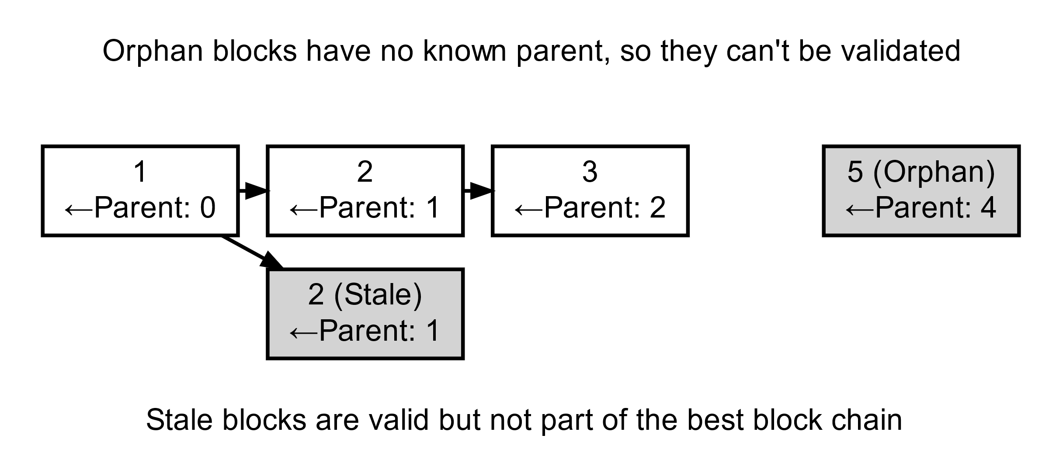
Ref. Orphan Blocks

Slide 28
Blockchain Forks (1/4)
(Due to transmission delays)
Because the blockchain is a decentralized data structure, different copies of it are not always consistent.
Blocks might arrive at different nodes at different times, causing the nodes to have different perspectives of the blockchain.
To resolve this, each node always selects and attempts to extend the chain of blocks that represents the most Proof-of-Work, also known as the longest chain or greatest cumulative work chain.
Forks occur as temporary inconsistencies between versions of the blockchain, which are resolved by eventual reconvergence as more blocks are added to one of the forks.
The blockchain forks described here occur naturally as a result of transmission delays in the global network.

Slide 29
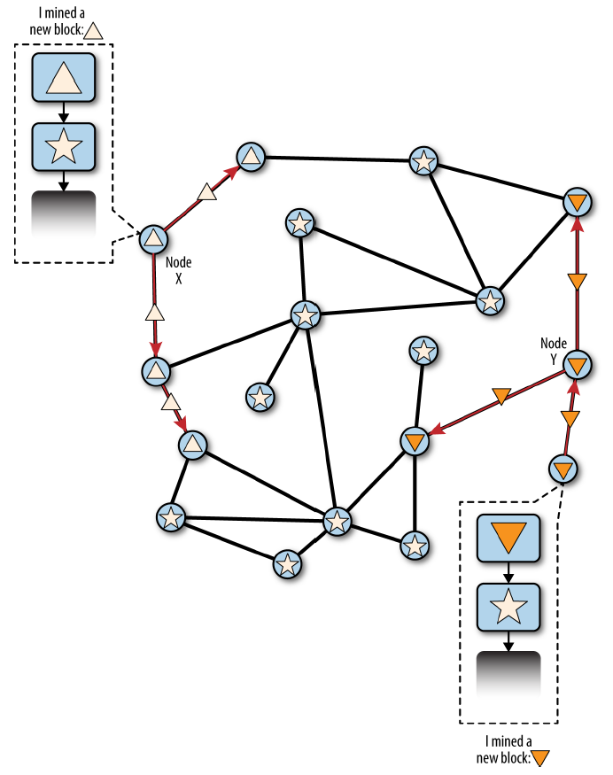
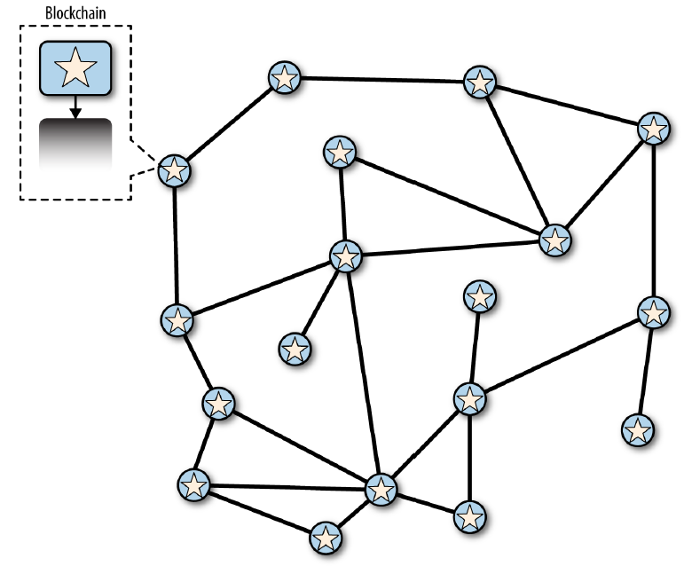
Blockchain Forks (2/4)
Figure 10-2. Before the fork—all nodes have the same perspective
Figure 10-3. Visualization of a blockchain fork event: two blocks found simultaneously

Slide 30
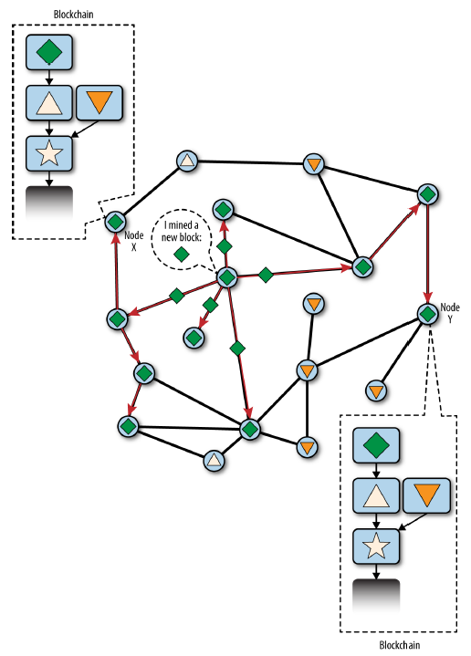
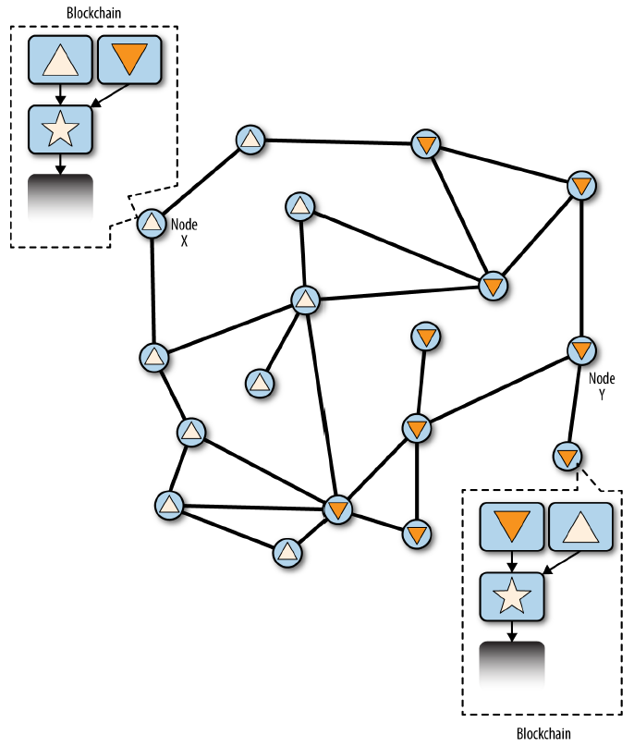
Blockchain Forks (3/4)
Figure 10-5. Visualization of a blockchain fork event: a new block extends one fork, reconverging the network
Figure 10-4. Visualization of a blockchain fork event: two blocks propagate, splitting the network

Slide 31
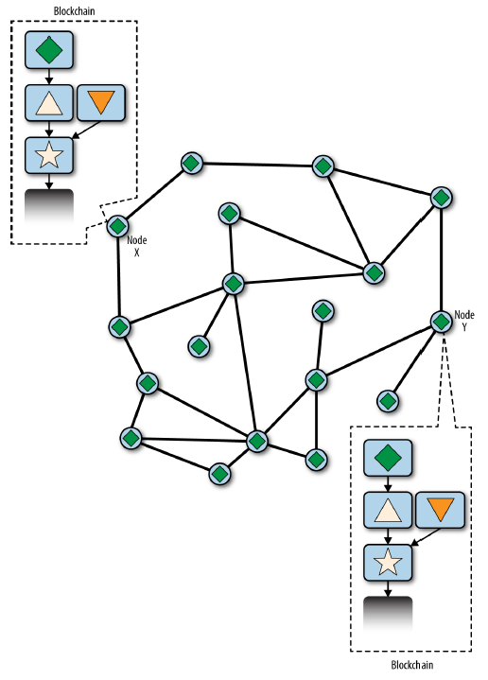
Blockchain Forks (4/4)
Forks are almost always resolved within one block.
Even if the hashing power is almost evenly split, it is likely that one set of miners will find a solution and propagate it before the other set of miners have found any solutions.
It is theoretically possible for a fork to extend to two blocks, if two blocks are found almost simultaneously by miners on opposite “sides” of a previous fork. However, the chance of that happening is very low.
Figure 10-6. Visualization of a blockchain fork event: the network reconverges on a new longest chain

Slide 32
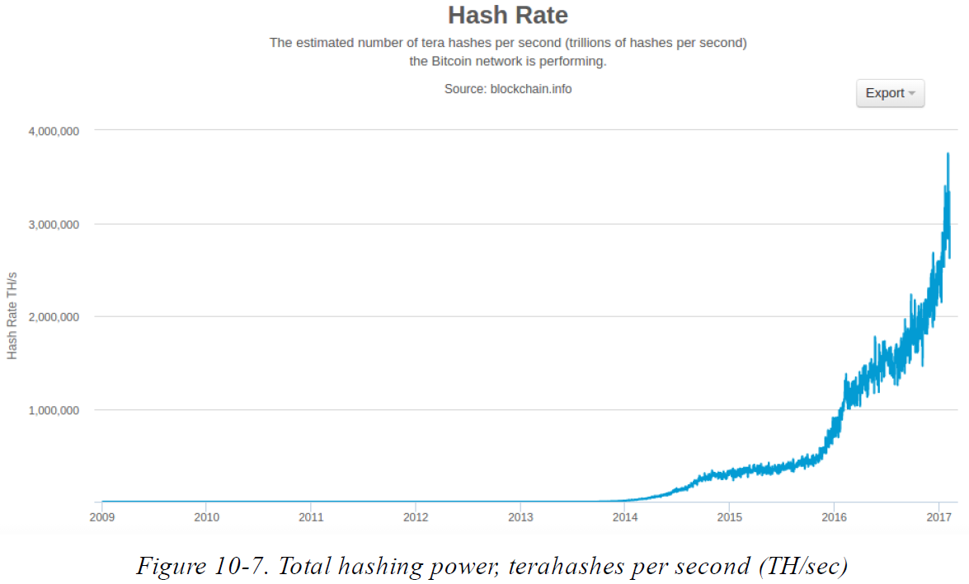
Mining and the Hashing Race (1/2)

Slide 33
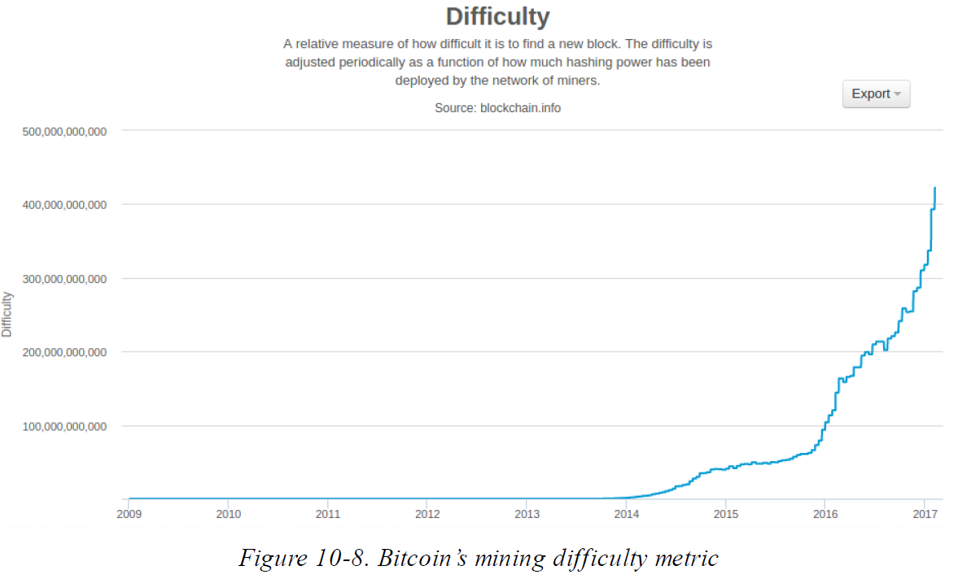
Mining and the Hashing Race (2/2)
The difficulty metric in the chart is measured as a ratio of current difficulty over minimum difficulty (the difficulty of the first block).

Slide 34
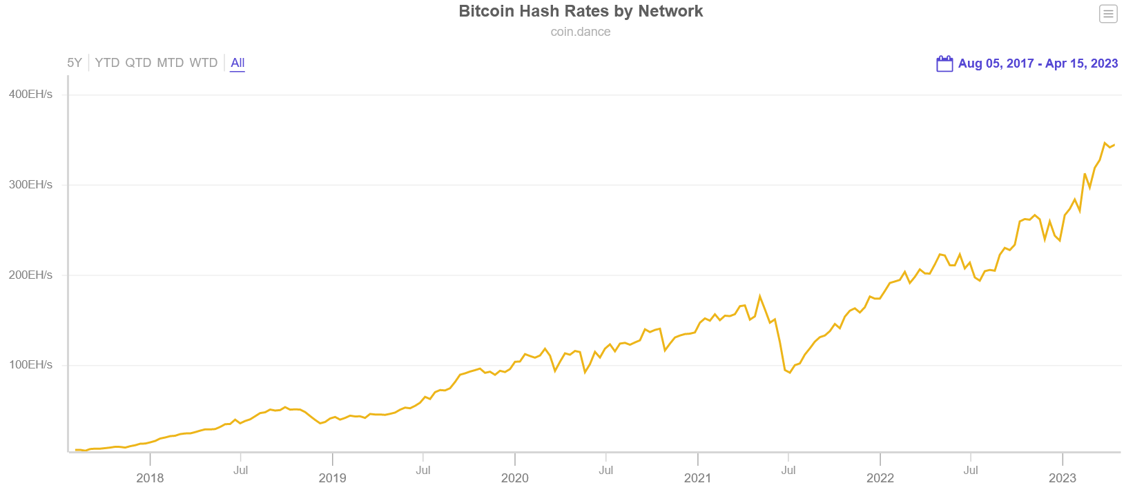
Bitcoin Hash Rates
Exa Hashes per second (EH/s), which equals one Quintillion (10¹⁸) hashes.

Slide 35
Consensus Attacks (1/5)
Bitcoin’s consensus mechanism is, at least theoretically, vulnerable to attack by miners (or pools) that attempt to use their hashing power to dishonest or destructive ends.
If a miner or group of miners can achieve a significant share of the mining power, they can attack the consensus mechanism so as to disrupt the security and availability of the bitcoin network.
Consensus attacks can only affect future consensus, or at best, the most recent past (tens of blocks). Bitcoin’s ledger becomes more and more immutable as time passes.
A consensus attack cannot steal bitcoin, spend bitcoin without signatures, redirect bitcoin, or otherwise change past transactions or ownership records.
Consensus attacks can only affect the most recent blocks and cause denial-of-service disruptions on the creation of future blocks.

Slide 36
Consensus Attacks (2/5)
51% Attack Scenario
In this scenario a group of miners, controlling a majority (51%) of the total network’s hashing power, collude to attack bitcoin.
With the ability to mine the majority of the blocks, the attacking miners can cause deliberate “forks” in the blockchain and double-spend transactions or execute denial-of-service attacks against specific transactions or addresses.
A fork/double-spend attack is where the attacker causes previously confirmed blocks to be invalidated by forking below them and re-converging on an alternate chain.
With sufficient power, an attacker can invalidate six or more blocks in a row, causing transactions that were considered immutable (six confirmations) to be invalidated.

Slide 37
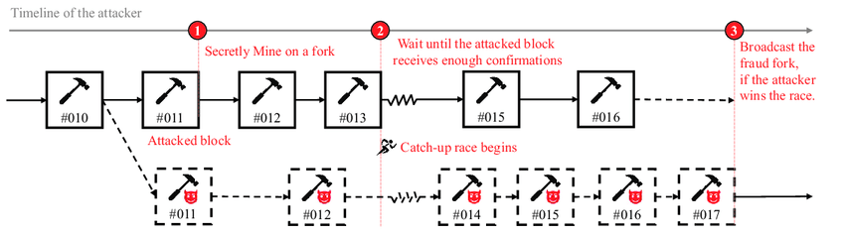
Consensus Attacks (3/5)
Note that a double-spend can only be done on the attacker’s own transactions, for which the attacker can produce a valid signature.
Double-spending one’s own transactions is profitable if by invalidating a transaction the attacker can get an irreversible exchange payment or product without paying for it.

Slide 38
Consensus Attacks (4/5)
To protect against this kind of attack (double-spend), a merchant selling large-value items must wait at least six confirmations before giving the product to the buyer.
In addition to a double-spend attack, the other scenario for a consensus attack is to deny service to specific bitcoin participants (specific bitcoin addresses).
An attacker with a majority of the mining power can simply ignore specific transactions. If they are included in a block mined by another miner, the attacker can deliberately fork and remine that block, again excluding the specific transactions.

Slide 39
Consensus Attacks (5/5)
Despite its name, the 51% attack scenario doesn’t actually require 51% of the hashing power.
Such an attack can be attempted with a smaller percentage of the hashing power. The 51% threshold is simply the level at which such an attack is almost guaranteed to succeed.
Not all attackers will be motivated by profit. One potential attack scenario is where an attacker intends to disrupt the bitcoin network without the possibility of profiting from such disruption.
All of these scenarios are theoretically possible, but increasingly impractical as the bitcoin network’s overall hashing power continues to grow exponentially.

Slide 40
Changing the Consensus Rules
In order to evolve and develop the bitcoin system, the rules have to change from time to time to accommodate new features, improve-ments, or bug fixes.
Unlike traditional software development, upgrades to a consensus system are much more difficult and require coordination between all the participants.
Hard Fork
Scenario in which the network may diverge into following two chains by a change in the consensus rules. After the fork the network does not reconverge onto a single chain. Instead, the two chains evolve independently.
Hard forks occur when part of the network is operating under a different set of consensus rules than the rest of the network.
A change introduced by a hard fork can be thought of as not “forward compatible,” in that nonupgraded systems can no longer process the new consensus rules.

Slide 41
Hard Forks: Software, Network, Mining, and Chain
Conceptually, we can think of a hard fork as developing in four stages: a software fork, a network fork, a mining fork, and a chain fork.
The process begins when an alternative implementation of the client, with modified consensus rules, is created by developers.
When this forked implementation is deployed in the network, a certain percentage of miners, wallet users, and intermediate nodes may adopt and run this implementation.
Nodes based on the original implementation of the consensus rules will reject any transactions and blocks that are created under the new rules. As a result, the network will partition into two: old nodes will only remain connected to old nodes and new nodes will only be connected to new nodes.
Once a miner using the new rules mines a block, the mining power and chain will also fork.

Slide 42


Hard Forks: Software Forks
For software developers, the term “fork” has another meaning, adding confusion to the term “hard fork.”
In open source software, a fork occurs when a group of developers choose to follow a different software roadmap and start a competing implementation of an open source project.
In the case of a deliberate change to the consensus rules, a software fork precedes the hard fork. However, for this type of hard fork to occur, a new software implementation of the consensus rules must be developed, adopted, and launched.
Once a user upgrades their software, that version rejects all transactions from older software, effectively creating a new branch of the blockchain. It is through this forking process that various digital currencies with names similar to bitcoin have been created, including bitcoin cash and bitcoin gold.

Slide 43
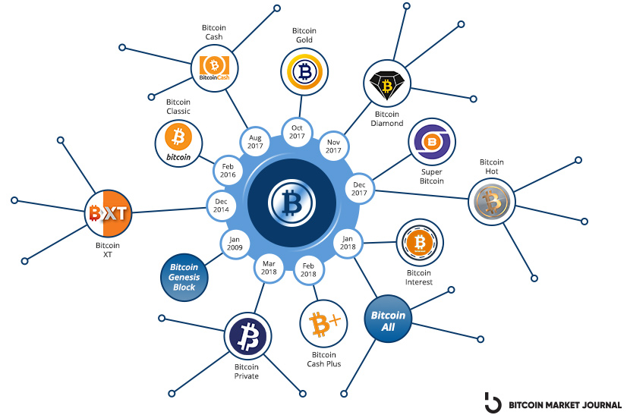
Ref. Bitcoin Hard Forks
https://www.investopedia.com/tech/history-bitcoin-hard-forks/
https://blog.unocoin.com/impact-of-forking-on-cryptocurrency-282638143c66
Bitcoin cash remains the most successful hard fork of the primary cryptocurrency; as of June 2021, it is the eleventh-largest digital currency by market cap.
Bitcoin XT was one of the first notable hard forks of bitcoin.

Slide 44
Soft Forks
Not all consensus rule changes cause a hard fork. Only consensus changes that are forward-incompatible cause a (hard) fork.
If the change is implemented in such a way that an unmodified client still sees the transaction or block as valid under the previous rules, the change can happen without a fork.
The term soft fork was introduced to distinguish this upgrade method from a “hard fork.” In practice, a soft fork is not a fork at all.
A soft fork is a forward-compatible change to the consensus rules that allows un-upgraded clients to continue to operate in consensus with the new rules.
Soft fork upgrades can only be used to constrain the consensus rules, not to expand them. In order to be forward compatible, transactions and blocks created under the new rules must be valid under the old rules too, but not vice versa.

Slide 45
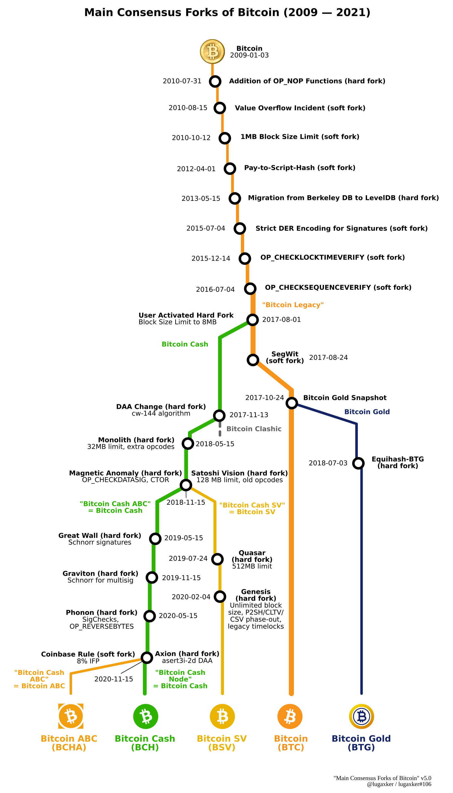
Ref. Bitcoin Consensus Forks
https://www.reddit.com/r/btc/comments/e1p3ki/a_map_of_the_main_consensus_forks_of_bitcoin/
BIP-9

Slide 46
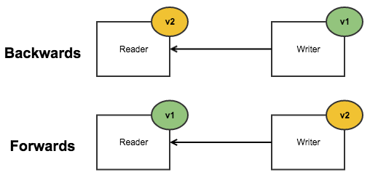
Ref. Backward vs. Forward Compatibility
Q. Is Hard fork backward compatible? No
Q. Is Hard fork forward compatible? No
Q. Is Soft fork backward compatible? Yes
Q. Is Soft fork forward compatible? Yes
Hard Fork
Blocks
V2 Node
V1 Node
Soft Fork
Blocks
V2 Node
✓
V1 Node

